Slide 1
Boolean Indexing

Slide 2
Boolean indexing is a type of indexing which uses actual
values of the data in the DataFrame. In boolean indexing,
we can filter a data in four ways –
Accessing a DataFrame with a boolean index
Applying a boolean mask to a dataframe
Masking data based on column value
Masking data based on index value

Slide 3
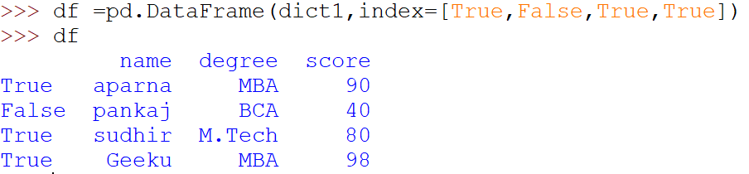
Accessing a DataFrame with a boolean index
# dictionary of lists
dict = {'name':["aparna", "pankaj", "sudhir", "Geeku"],
'degree': ["MBA", "BCA", "M.Tech", "MBA"],
'score':[90, 40, 80, 98]}
df = pd.DataFrame(dict, index = [True, False, True, False])
print(df)

Slide 4
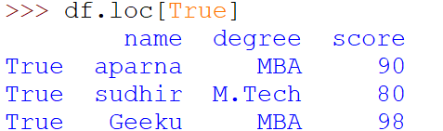
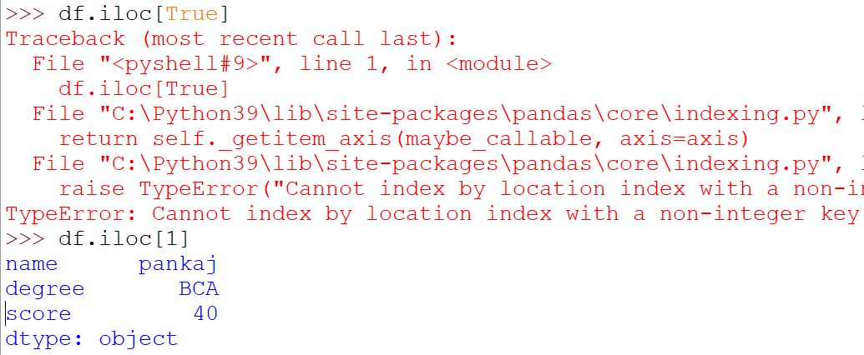
Accessing DataFrame using loc() function

Slide 5
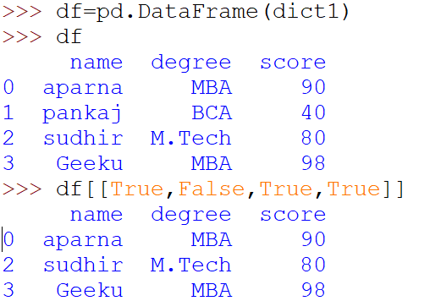
Applying a boolean mask to a dataframe
dict1 = {'name':["aparna", "pankaj", "sudhir", "Geeku"],'degree': ["MBA", "BCA", "M.Tech", "MBA"],'score':[90, 40, 80, 98]}

Slide 6
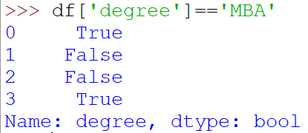
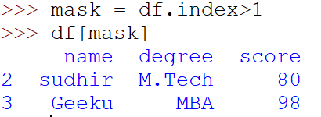
Applying a boolean mask to a dataframe
dict1 = {'name':["aparna", "pankaj", "sudhir", "Geeku"],'degree': ["MBA", "BCA", "M.Tech", "MBA"],'score':[90, 40, 80, 98]}

